Slide 1


Personalized Finance Recommender

Slide 2
Team Members
Name | Roll No
Alfaj Mulla | 58
Sanika Navle | 62
Akash Gurav | 63
Jay Pawar | 77

Slide 3
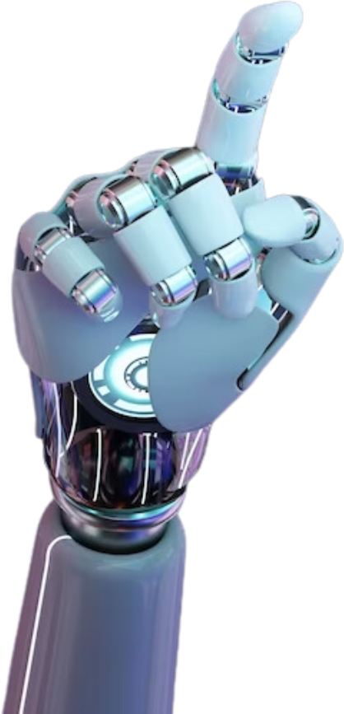

Problem Statement
Traditional investment approaches often fail to address individual investors’ unique financial goals, risk appetites, and preferences, leading to suboptimal decisions. Retail investors face challenges such as information overload, lack of expertise in analyzing market trends, and difficulty balancing risk-return trade-offs. Additionally, generic financial advice rarely adapts to dynamic market conditions or evolving personal circumstances, resulting in portfolios that may not align with users’ long-term objective.

Slide 4
Introduction
In an era of rapidly evolving financial markets, retail investors increasingly face a critical challenge: navigating complex investment landscapes without access to personalized, adaptive guidance. Traditional wealth management solutions often rely on generic, one-size-fits-all strategies that fail to account for individual financial goals, risk tolerance.
A Personalized Investment Recommendation System addresses these gaps by combining advanced analytics, machine learning, and financial expertise to deliver tailored investment strategies. Unlike static models, this system dynamically adapts to real-time market shifts, macroeconomic trends, and user-specific changes.

Slide 5
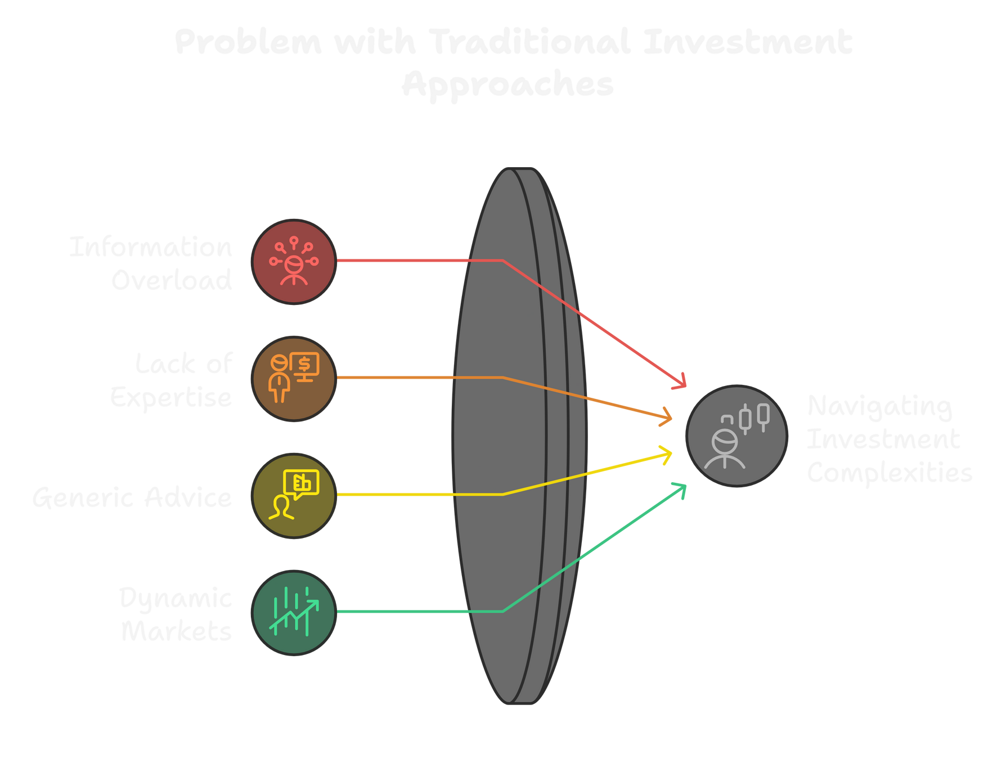

Slide 6

Why Personalized Finance Recommender
In today’s fast-paced financial markets, retail investors need personalized, adaptive guidance
Traditional wealth management solutions are static and generic
Our solution uses AI and machine learning to provide tailored investment strategies
The Need for Personalization:
Unique financial goals, varying risk tolerance, dynamic markets.

Slide 7
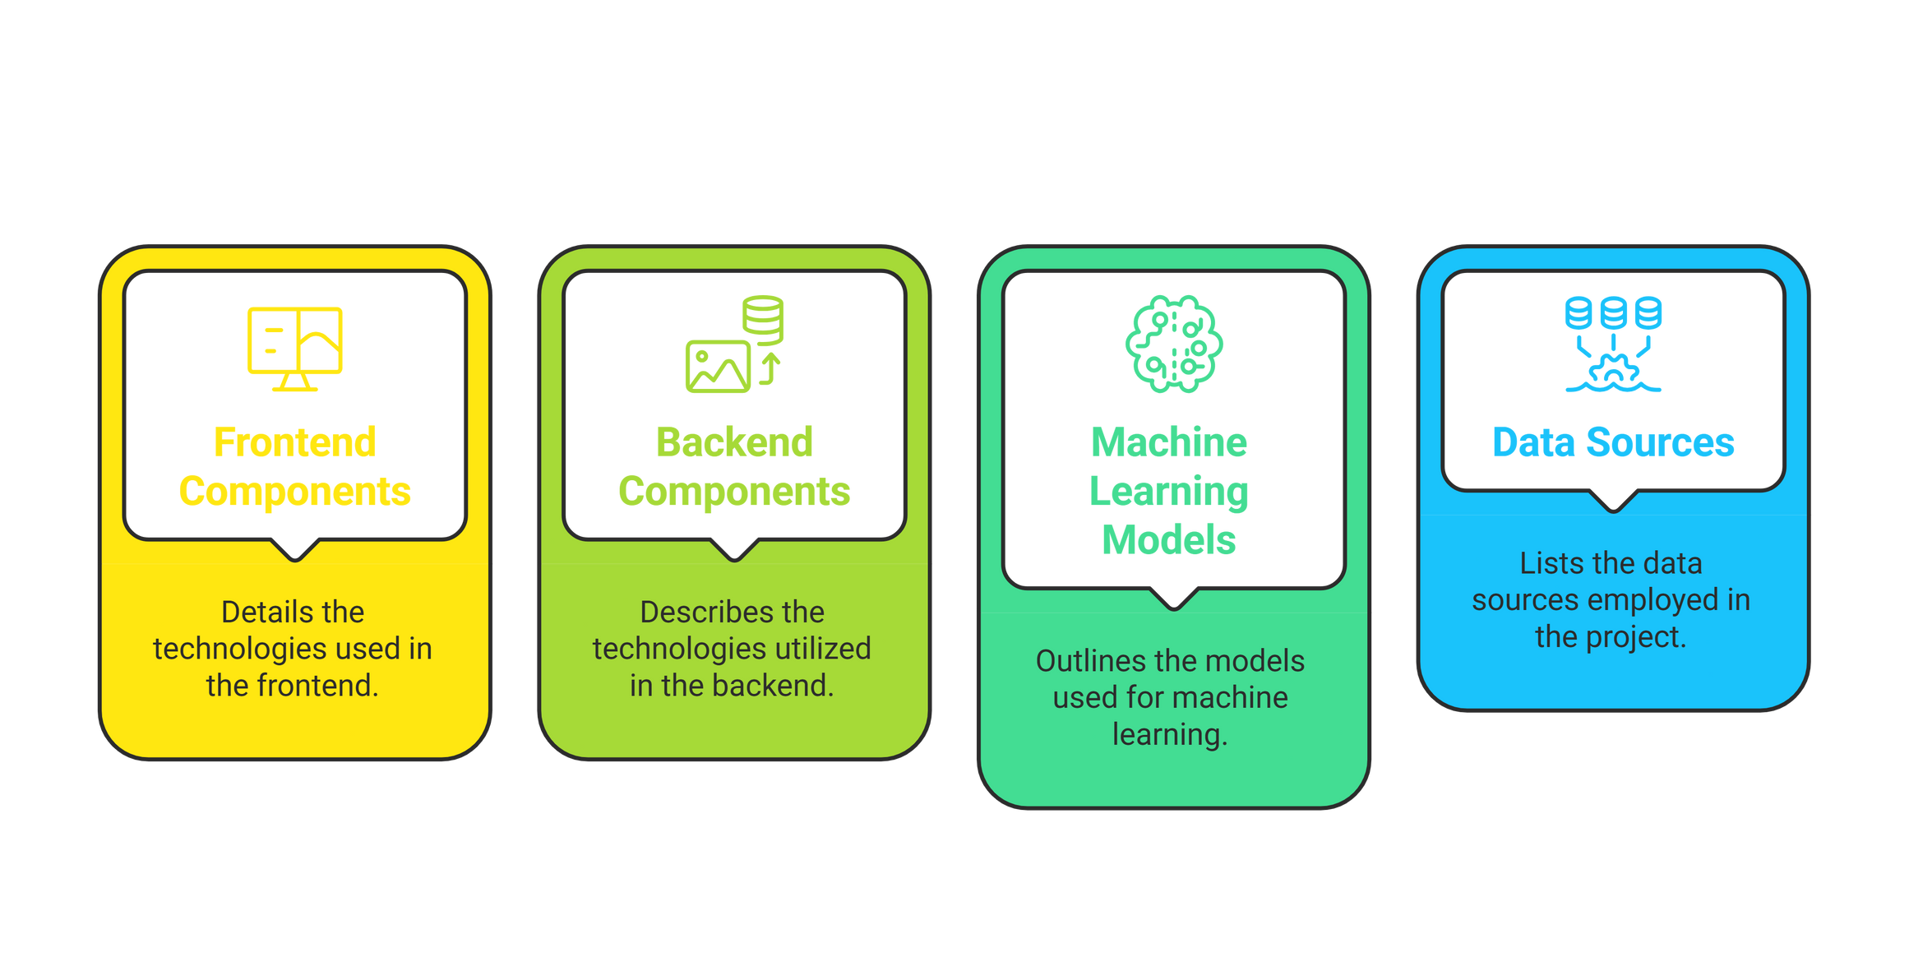
Tech Stack

Slide 8
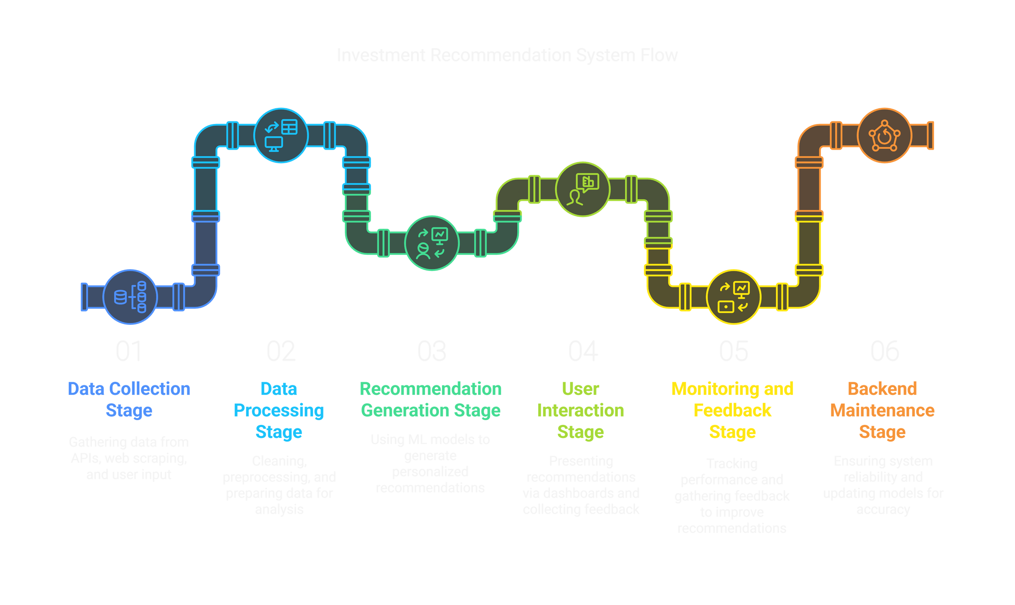

Slide 9

1
Personalized Recommendations
2
Goals
Dynamic risk management
3
Real-Time market analysis
4
User education and transparency

Slide 10
1
User Profile
2
Key Features
Market Data Analysis
3
Recommendation Engine
4
Risk Assessment

Slide 11
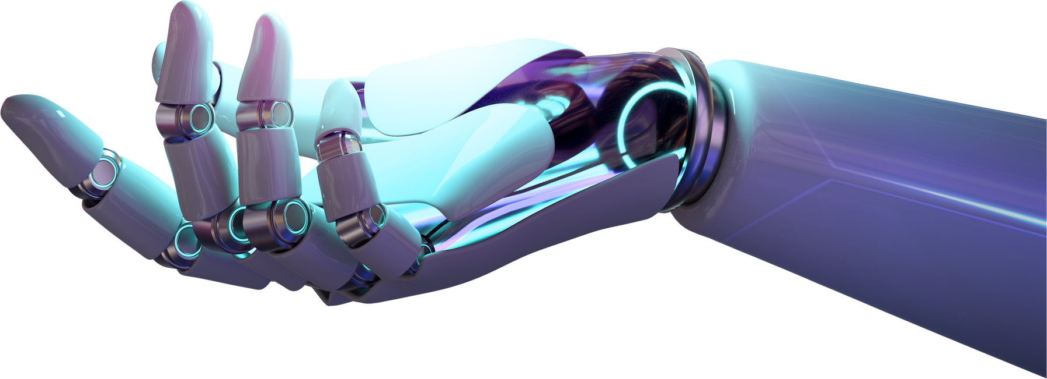

Thank You

